Slide 1
Usability Engineering Tools 2
Usability Test
Prof. Dr. Christian Reimann

Slide 2
5 second test

Slide 3
5-Second-Test
Goal: Check the first impression!!
More a design or marketing instrument, than a usability tools
Quick and easy to accomplish
Based mainly upon two effects observed in human communication
Primacy- (Recency-) effect
Halo-effect
Those effects work in human<>computer communication as well!!

Slide 4
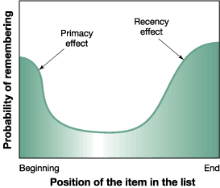
Primacy & Recency effect
Notes:
Ist das erste Gefühl positiv, wird der Rest der Seite positiver bewertet
Erste Interaktion gestaltet sich nach den ersten Informationen
Erste Eindruck vermittelt dem Nutzer den Kontext/Inhalt
Entspricht die zuerst gewonnene Information nicht der Erwartung, springt der Nutzer ab

Slide 5
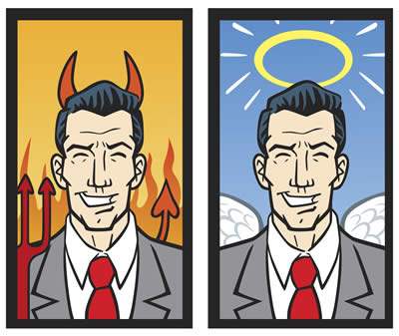
Halo effect

Slide 6
Halo effect
Notes:
Schlussfolgerung vom ersten Eindruck auf den Inhalt der Seite – Aufbau der Startseite professionell - > Inhalt professionell – Startseite kompliziert -> Verkaufssystem kompliziert
Positiver Ersteindruck lässt kleinere Mängel verschwinden

Slide 7
Why 5 seconds?
Impression
Definition
Relevance
The Hook
Action

Slide 8
Test Design
Define context for the user
A few lines of text max.
Show screenshot of application for 5 seconds
Screenshot makes sure the user can not do anything
Not even scrolling
Ask a set of predefined questions (avoid yes/no)
„What does this website offer?“
„What company is offering something?“
„Where is the connection with XYZ?“
„How can you contact the company?“
...

Slide 9
Problems? Restrictions?

Slide 10
Be aware!
5-Second-Tests checks only the first (subjective) impression!!!
It says nothing about
Effectiveness
Efficiency
Satisfaction
Functionality
Logic
Wording
Interaction
...

Slide 11
Simple „Howto“
Choose an application
Setup 5-Second-Test
https://usabilityhub.com/
Document decisions (why, which questions, etc.)
Make other groups test
Evaluate results

Slide 12
UI Tests general approach

Slide 13
Prerequisites for a Test
Goal of the test (What do we wnt to learn from it?)
Material from project
- Target Audience (e.g. as Personas)
- Tasks (e.g. user stories, use cases)
Decide which tasks to test
Create a task description
- realistic
- do not make it a „how to“
- do not use any wording from your application

Slide 14
Example
Scenario:
You are researcher max miller and want to give a presentation at the „NewHotResearch“-Conference, which will be in Los Angeles this year.
Task 1:
You are interested in finding a cheap accomodation. Use the conference website to find a hotel.
Task 2:
You want to take a rental car to drive from the airport to the conference. Use the conference website to find information about parking possibilities.
Task 3:
You want to use the opportunity to meet other researchers and discuss some ideas with them. Find out who else will be there.

Slide 15
The test itself
Welcome the tester and give an introduction
Point out that you are testing the sw, not the tester
Explain the procedure
Tester can interrupt at any time
(motivate to „think aloud“)
Do not intervene during the tasks!! No! Don‘t!
Do not influence the tester
Do not answer questions
When the tasks are done, do interviews or fill questioniares.
Thank the tester

Slide 16
Some tools and methods „fast forward“

Slide 17
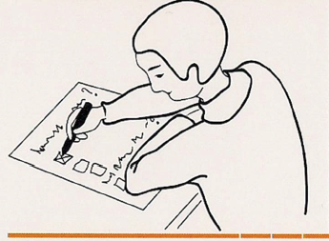
Tools and Methods
(Online) Questionnaire
A 6
(Online) Questionnaire
ISONORM
ISO 9241 Part 110
5 questions for each design principle (7)
Suitability for the task
Learning support
Error tolerance and so on
7-stage scale (- - -) to (+ + +)
Skills / expertise of the respondents
Summarizing judgment + free test
→ General impression of usability
AttrakDiff
Aspect of the joy of use
Measure of hedonic quality (Certified Fun)
Quantitative comparability
Usability / look / attractiveness
23 contrasting pairs of terms, scale 1-7
„sympathetic-unsympathetic“
Phase A: Analysis
(Online) Questionnaire: Questionnaires (usually standardized) are used in many ways, e.g. identifying usability problems or to cover the user requirements for an interactive system.
Fun factor: 25%
Experience: Advanced
Participant: per group 200 test persons
Resources: middle
Notes:
Wahl des Fragenbogens: Standardisiert / TeilsTeils / Selbst erstellt
Post / E-Mail / Online
IsoMetrics = kurze Version mit numerischer Bewertung und lange Version mit Verbesserungsvorschlägen

Slide 18
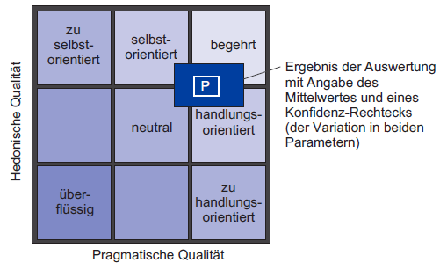
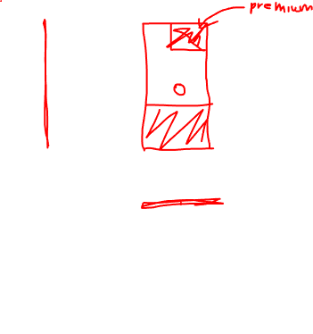
Tools and Methods
(Online) Questionnaire
A 6
AttrakDiff
Aspect of the joy of working
Measure of hedonic quality (Certified Fun)
Quantitative comparability
Usability / look / attractiveness
23 contrasting pairs of terms, scale 1-7
„sympathetic-unsympathetic“
Phase A: Analysis
(Online) Questionnaire: Questionnaires (usually standardized) are used in many ways, e.g. identifying usability problems or to cover the user requirements for an interactive system.
Fun factor: 25%
Experience: Advanced
Participant: per group 200 test persons
Resources: middle
Notes:
Benutzertest

Slide 19
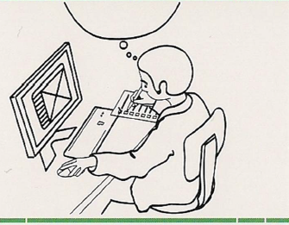
Tools and Methods
Cognitive Walkthrough
B 4
Experts put themselves in the role of a user and test an interactive system from this point of view!
Steps to do (summarized)
Input:
Assumptions about the user
Prepare the task to do (goal?)
Define the work flow
Find the ideal way to reach the goal
Execute the task:
from the viewpoint of a user
Find and write down any problems
Evaluate the problems
Rework the interactive system
Solve the problems
The Assumption has to be right!!!
Phase B: Concept / Development
Cognitive walkthrough: Inspection method, in which usability experts run through pre-defined action sequences of an interactive system with the lowest cognitive effort (viewpoint of a user!).
Fun factor: 50%
Experience: Expert
Participant: several experts
Resources: low

Slide 20
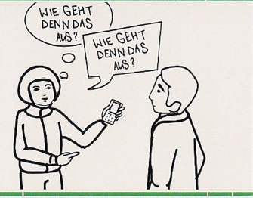
Tools and Methods
Think loud
B 6
Test procedure – Hallway-Testing
Find the next best colleague, get her/him to your workplace and let her/him test the interactive system
Process:
Brief explanation what to do
Give her/him a simple task
Don’t give any clues for the solution
Ask the colleague to think aloud
Repeat this process for several times
But with different colleagues ☺
If it is only a newer version of the system
Choose colleagues without previous knowledge
But…
Colleagues aren’t experts nor users
Phase B: Concept / Development
Think loud: Method in which the user verbalizes all his thoughts loud while completing tasks with the interactive system.
Fun factor: 75%
Experience: Beginner
Participant: each method 10 test persons
Resources: low

Slide 21
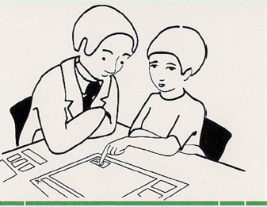
Tools and Methods
Paper prototyping
B 7
Prototyping
Exemplary embodiments of the user interface to be validated
Important part of an iterative process
Goal: practical integration of the user
Prototype realizes some parts of the interactive system
Complete work process
Some users work with the prototype
Deliver Tasks and Scenarios
Feedback about experience by the user
Paper-Prototypes
Disposal -Prototypes
Phase B: Concept / Development
Paper prototyping: For the first evaluation of graphical user interfaces (GUI) the elements of the GUI will be drawn and presented to the test person in a specific scenario.
Fun factor: 100%
Experience: Advanced
Participant: min. 8 to 10 test persons
Resources: low

Slide 22
Tools and Methods
Paper prototyping
B 7
Prototyping
Exemplary embodiments of the user interface to be validated
Low-Fidelity-Prototypes (Disposable Prototypes):
Sketchy design
Not on target platform
Rudimentary, without functionality
For early development phases
High-Fidelity-Prototypes: (include functionality)
Platform-specific implementation
Ready for interactions
Allows comparison of the advantages and disadvantages of several solutions
Phase B: Concept / Development
Paper prototyping: For the first evaluation of graphical user interfaces (GUI) the elements of the GUI will be drawn and presented to the test person in a specific scenario.
Fun factor: 100%
Experience: Advanced
Participant: min. 8 to 10 test persons
Resources: low

Slide 23
Tools and Methods
Paper prototyping
B 7
Links to create paper prototypes:
http://builds.balsamiq.com/b/mockups-web-demo/
Online Demo mockup software
Of course there are several other tools, but this one above has not to be installed and is self-explanatory
Phase B: Concept / Development
Paper prototyping: For the first evaluation of graphical user interfaces (GUI) the elements of the GUI will be drawn and presented to the test person in a specific scenario.
Fun factor: 100%
Experience: Advanced
Participant: min. 8 to 10 test persons
Resources: low

Slide 24
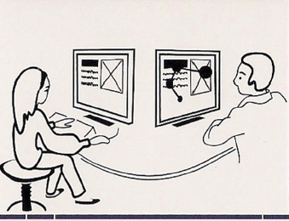
Tools and Methods
Eye tracking
C 1
Question:
Where does the user look at and how much time is spent for it?
Scope:
Optimization of frequently used screens
Used in usability laboratory
Be careful:
Influence is possible because of the environment of the laboratory
Devices are very expensive
Phase C: Implementation
Eye tracking: Measurement of eye movements and time spent on each item when using an interactive system.
Fun factor: 100%
Experience: Expert
Participant: 10 to 15 test persons
Resources: very high

